Slide 1
Application-Network Integration: Possibilities, Challenges, and Possible Next Steps
Y. Richard Yang
IETF 106
November 20, 2019
Singapore

Slide 2
Application-Aware (AA) Networks Can Have Diverse AA Capabilities, Requiring Different Support
Example Capability | Possible Support & Assumption
Treat each packet the same (aka not AA)
Aware at app-level granularity
Create different networks/slices (e.g., voice vs data networks)
IP, access; SDN; scheduling
Identify packets by ports (e.g., ACL)
Packet header port; scheduling
Aware of sub-app granularity
Scheduling each packet according to app-level deadline (e.g., fastpass’14)
Custom packet header; scheduling
Distinguish application-level structures (e.g., I frame vs P frame)
Fancy: Co-flow scheduling (e.g., VARYS’14, AALO’15)
Network state; scheduling
Aware of cross-app/protocol dependency
Packet header; net state; scheduling
Fancy: identify full dependency (e.g., applicationlevel dependency such as DNS->handshake->…)
Network state; scheduling
…

Slide 3
Network-Aware (NA) Applications Can Have Diverse NA Capabilities, Requiring Different Network Information/Support
Example Capability | Support & Assumption
Transfer time selection
Network state in time; can delay
Path properties from client to potential servers; has multiple servers
Server direction
Rate adaptation
None/None/ECN/INT
CC, reacting to loss/delay/ECN bit/INT (e.g., HPCC’19)
Adaptive streaming
Lower-than-best-effort (e.g., LEDBAT)
Multi-path TCP
…

Slide 4
Despite Broad Capabilities, A Simple Gap Example
Collaborative, distributed, exa-scale data sciences [1]
Applications: LHC, LIGO, LSST, EHT …
Services
Time-Block-Maximum Bandwidth
Application asks for a specific time block and would like to know (or provision) the maximum bandwidth available for a specific time period.
Bandwidth-Sliding-Window
Application asks for a specific bandwidth and duration and provides an acceptable time window. For example, a request may be for 40 Gbps for a 10-hour time window, sometime in the next 3 days.
Time-Bandwidth-Product (TBP)
Application asks for “8 hours of transfer at 10Gbps” representing a TBP of 36 TBytes. The user also specifies an acceptable time window, and other options such as “prefer the highest bandwidth rate available”, or the lowest.
Protocol outcomes
Immediate provision
What is Possible?
Negotiation
[1] http://sense.es.net/services
Notes:
Time-Block-Maximum Bandwidth: Application asks for a specific time block and would like to know (or provision) the maximum bandwidth available for a specific time period.
Bandwidth-Sliding-Window: Application asks for a specific bandwidth and duration and provides an acceptable time window. For example, a request may be for 40 Gbps for a 10-hour time window, sometime in the next 3 days.
Time-Bandwidth-Product (TBP): Application asks for “8 hours of transfer at 10Gbps” representing a TBP of 36 TBytes. The user also specifies an acceptable time window, and other options such as “prefer the highest bandwidth rate available”, or the lowest.
Immediate Provision: If SENSE finds a resource path which satisfies the application request, provisioning starts immediately (after routine confirmations from both sides).
What is Possible?: In this mode, SENSE simply conducts a “Resource Computation” and provides the results back to the requestor. No provisioning action is taken without further explicit requests from the user.
Negotiation: One or more rounds of Resource Computation requests with subsequent provisioning request by the application user if desired.

Slide 5
Basic Challenge: Architecture
Applications and networks can be designed with different objectives
Application: optimizes application’s utility
Network: optimizes network’s utility, enforces fairness, …
The end-to-end principle which mostly argues for the minimization of AA-networking
NA-Application
Cap & Info
Cap & Info
AA-Network

Slide 6
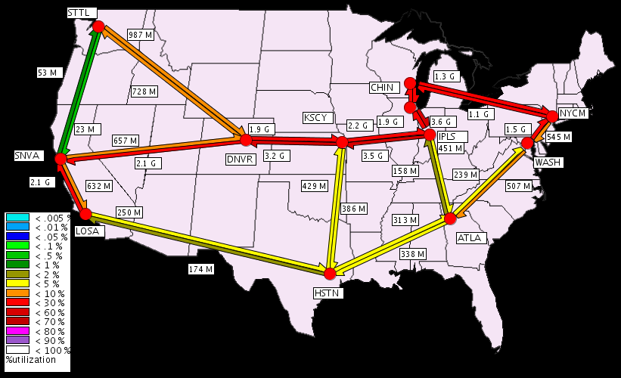
A Simple Example
Application objective: optimize total throughput
Using a fluid model*, we can derive that: optimizing throughput ⇒ maximizing up/down link capacity usage
Network objective: minimize maximum link utilization (MLU)
be: background traffic volume on link e
ce: capacity of link e
Ie(i,j) = 1 if link e is on the route from i to j
t^{k} : a traffic demand matrix {t^{k}ij} for each pair of nodes (i,j)

Slide 7
A Simple Example: System Formulation
Combine the objectives of network and applications
s.t., for any k,
T¹
t^{k}
T^{k}

Slide 8
Why Hard: Constraints Couple Net/App
Constraints couple network/applications together!

Slide 9
Solution Architecture: Decouple Network and Application
t^{k}
Introduce pe to decouple the constraints
T^{k}
pe
With dual variable pe (≥ 0) for the inequality of each link e, and dual finite condition
pij is the sum of pe along the path from node i to node j

Slide 10
Bigger Picture
The interface between applications and network is the dual variables {p_{ij}}
pe1(t)
pe2(t)
t^{k}(t)
t^{k}
T^{k}

Slide 11
From Simple Example to Real Design
At a high level, one may indeed consider both ALTO (estimation) and (per-packet) INT info as p_{ij}
Multiple steps to make progress
A systematic study of existing NAA capabilities and their support requirements
A systematic study of existing AAN capabilities and their support requirements
Systematic design of network and application abstraction spaces
applications
network states/configurations

