Slide 1
Network Aware 5G Cloud Interactive Service ----Cloud Gaming
Tencent Future Network Lab
Wei Huang, Yunfei Zhang

Slide 2
Industrial Background
Tencent Cloud Gaming
Tencent Instant Play and Tencent START
Already started the Collaboration with three Chinese Operators to provide cloud gaming services
SonyPlayStationNow
https://www.trustedreviews.com/opinion/what-is-playstation-now-a-guide-to-sony-s-streaming-service-2920562
Microsoft xCloud
https://blogs.microsoft.com/blog/2018/10/08/project-xcloud-gaming-with-you-at-the-center/
Liquidsky iCDN
https://enterprise.liquidsky.com/technology.html
Google Cloud
nVIDIA GeForce NOW
PaperSpace

Slide 3
Advantages of Cloud Gaming
Quick start & less local installation
No need to download gaming software for installation thus saving the time to start, time spend include both the download and installation time
Less CPU power required for rendering
No need to perform rendering with high-end processors
More device availability
Game can be played in most devices even without high end processors
Seamless switch
Less Piracy
Games are played on or rely on cloud servers

Slide 4
Cloud Gaming v.s. Traditional Application
Cloud Gaming vs. Traditional Gaming
Volume
30Mbps vs. 300kbps
User Client
Any equipment with decoder vs. Need expensive GPU
Technical
I,P frame vs. Operation instruction
Cloud Gaming vs. Live streaming and video conference
Client Side
No buffer or very small buffer vs. 2-8 seconds buffer
Delay Tolerance
Sensitive <100ms mostly vs. Several seconds
Interactive service is regarded as a potential killer application in 5G

Slide 5
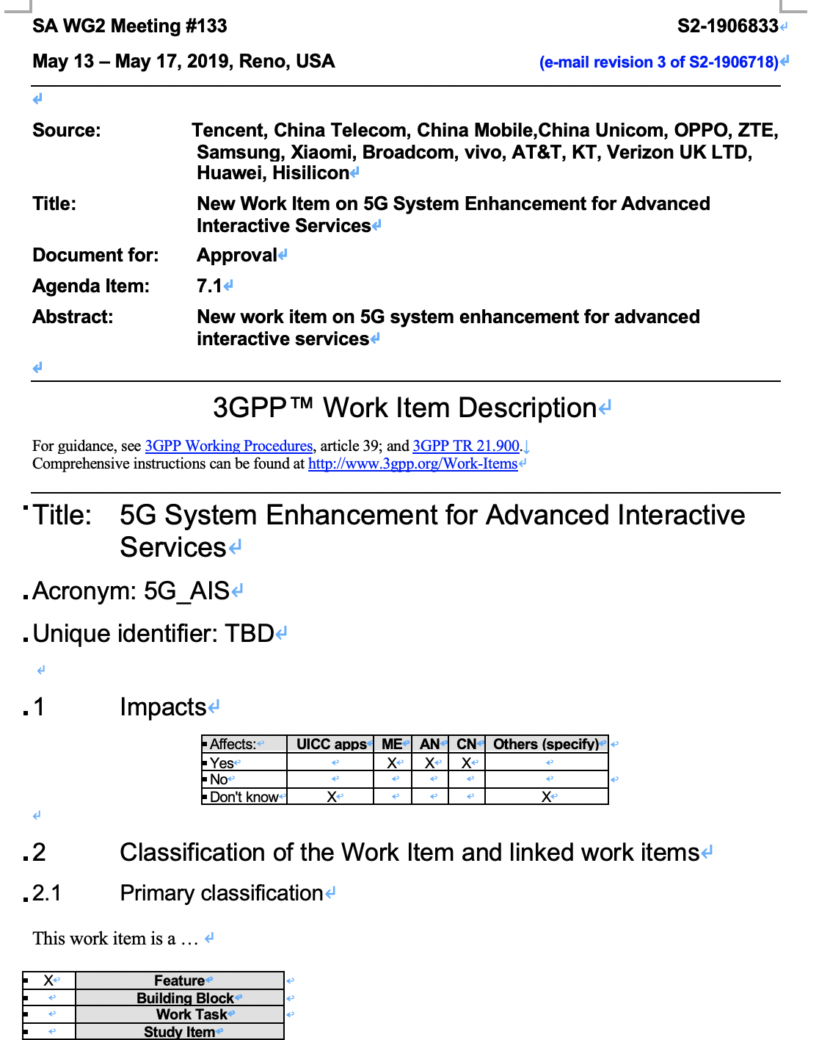
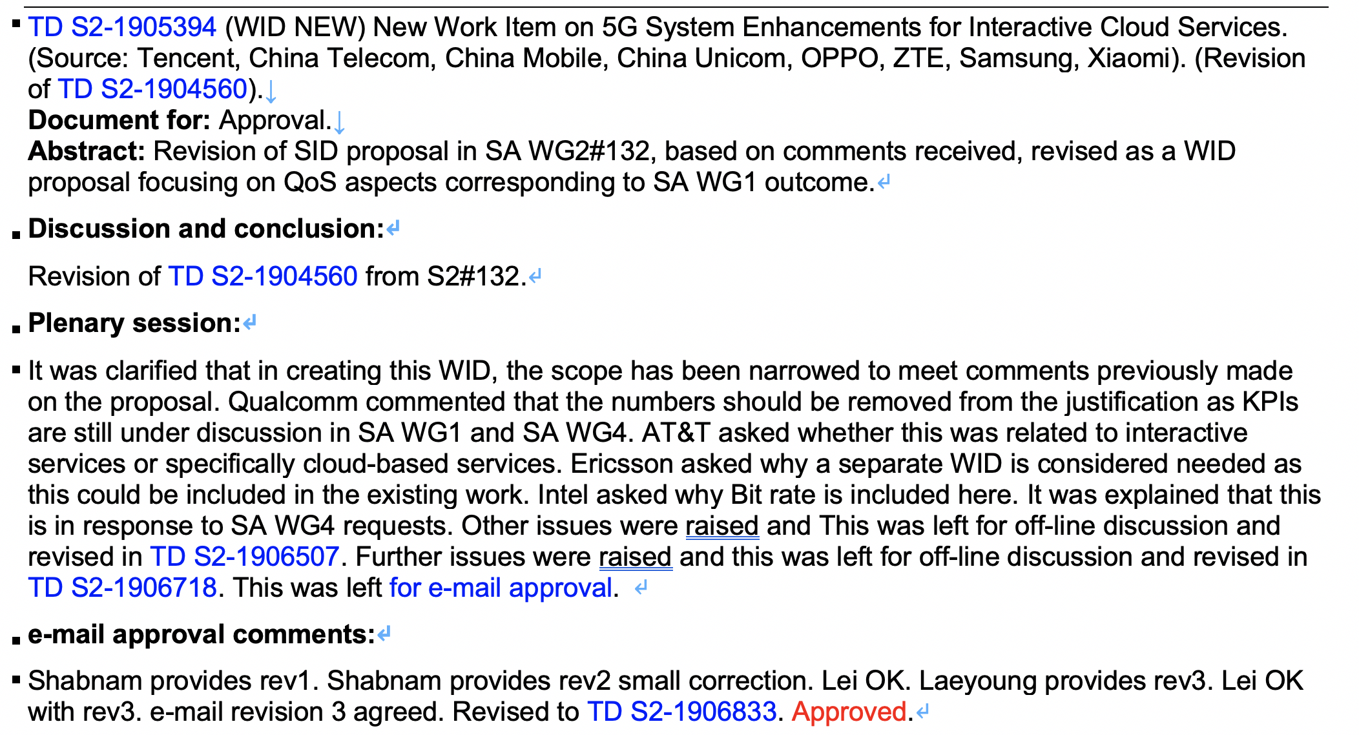
Tencent at SA2 5G—Cloud Gaming 5G-AIS

Slide 6
Cloud Gaming with Tencent MEC
Present
Resource Allocation in Cloud Gaming are based on IP, which can only show the city level.
Problem
If too many MEC in one city，service may occur 404 or 302
TMEC ability
Flow dyeing
Support DP of many companies
Central DC
Cloud Gaming Frame
Management
Edge DC
Cloud Gaming Server
TMEC
Flow dyeing
User Plane Function（UPF）
Edge UPF
Base Station
NOKIA DP
ZTE DP
Intel DP
…
Cloud Gaming Video
Request/Respond

Slide 7
Cloud Gaming System
Server
Network
Gaming Program
Gaming Logic
Rendering
User Client
Packeting
Streaming
Decode
Source Image
Operation Interpretation
Operational instruction and User Status
Saliency detection
Encode
Adaptive bitrate streaming
Network Status
Rate Value
Operational instruction
User Status

Slide 8
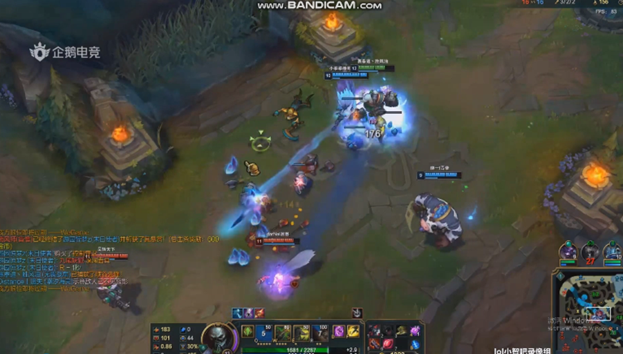
Saliency Detection and Video Compression
Problem:
Huge Video Size vs. Limited Bandwidth
Delay and Jitter
High Quality and High Delay Low Quality and Low delay
Saliency Detection：
1 Find the region of Interest
2 Saving bandwidth without harming users ' experience
3 Reducing peak bitrate
Our Work:
1 Increase the detection accuracy → Saving about 30% bandwidth under same QoE
2 Reduce detection speed → only 10ms-30ms
3 Changing algorithms and rate allocation (in one frame) based on the network status
Balance between detection delay and detection accuracy

Slide 9
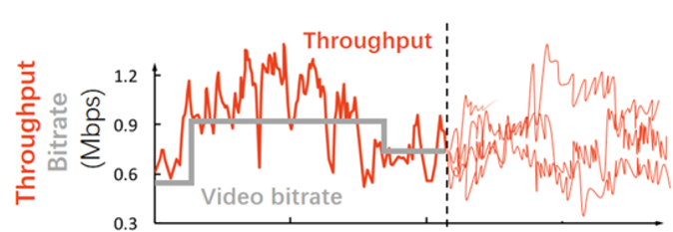
Adaptive Bitrate Streaming
High rate may cause delay
Low rate may harm the quality of experience
Most users are in wireless network (60% ↑ keep increasing)
Network fluctuation
To avoid large delay and guarantee quality: Video rates need to change with the network
Traditional Methods：
Reaction lag
Difficult on Trade off between Rate and Delay
Rely on Client Buffer
Not applicable to cloud gaming

Slide 10
Adaptive Bitrate Streaming
Our Work:
AI-based method (RL) to improve accuracy in cloud gaming environment
ABR on Delay Sensitive Scenario (Without Buffer)
Collecting Network Information (both from user client and server) to predict the best video rate
Reward
State
Agent
 | Traditional | AI-based
Bandwidth | 25M+ (PC) 10M (Mobile) | 15M-20M (PC) <8M (Mobile)
delay>200ms | Once every 2 minute | Once every 4 minute
Score (Dealy+rate+switch frequency) | 1700+ | 2800+ (much higher)
Past rate
Current buffer Frame delay
RTT time
Lost rate
……
Environment
Action
Rate Value

Slide 11
Network Aware Application
Data Source: Client side; Server side; Network side
Goal: Predict the change of network; balance between delay and rate
Future: Need more kinds of information which can reflect the network status (from operator and MEC)
Network Capability Exposure :
More information type reflect network status to help Reinforcement Learning → predict network performance
More frequency and more precise to help increase accuracy → to millisecond level and user level
Client Information (frame delay, buffer status)
Server Information (RTT time , video rate, frame rate, frame size…)
Uplink Channel
Application
Direct Connect
Private Link
Network Information (loss rate, cell load, mobile position information…)

Slide 12
Thank you！

Slide 13
5G network slicing for Cloud Gaming
1 Enhancing the experience of cloud gaming, reduce latency
2 Provide classified protection to users according to the different needs
User Client
Transport Network
Core network
Network slicing channel1
3 slicing modes
VIP user1
Server 1
Mobile number
application
position
Slicing user2
（application/mobile number）
5G BS1
UPF1
VIP slicing data
UPF2
Common data
Common user3~N
…
5G BS2
Common channel
Server 2

