Slide 1
Graphs, Vectors, and Matrices
Daniel A. Spielman
Yale University
AMS Josiah Willard Gibbs Lecture
January 6, 2016

Slide 2
From Applied to Pure Mathematics
Algebraic and Spectral Graph Theory
Sparsification:
approximating graphs by graphs with fewer edges
The Kadison-Singer problem

Slide 3
A Social Network Graph

Slide 4
A Social Network Graph

Slide 5
A Social Network Graph
“vertex”
or “node”
“edge” =
pair of nodes

Slide 6
A Social Network Graph
“vertex”
or “node”
“edge” =
pair of nodes

Slide 7
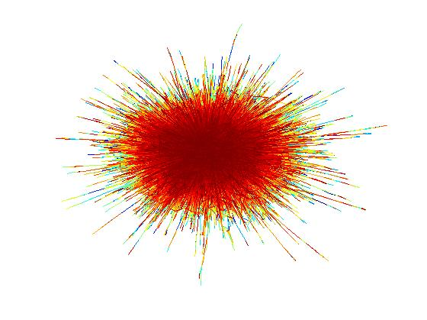
A Big Social Network Graph

Slide 8
A Graph
= vertices, = edges, pairs of vertices
1
2
3
5
7
11
4
6
9
8
12
10

Slide 9
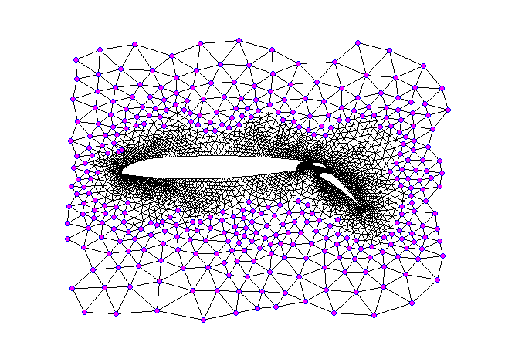
The Graph of a Mesh

Slide 10
Examples of Graphs
1
2
3
5
7
11
4
6
9
8
12
10

Slide 11
Examples of Graphs
1
2
3
5
7
11
4
6
9
8
12
10

Slide 12
How to understand large-scale structure
Draw the graph
Identify communities and hierarchical structure
Use physical metaphors
Edges as resistors or rubber bands
Examine processes
Diffusion of gas / Random Walks
Notes:
Maybe get rid of some of this?

Slide 13
The Laplacian quadratic form of
Notes:
Have an example here!

Slide 14
The Laplacian quadratic form of
1
0.5
1.5
0
1
0.5
Notes:
Have an example here!

Slide 15
The Laplacian quadratic form of
1
0.5
1.5
0
1
0.5
Notes:
Have an example here!

Slide 16
The Laplacian matrix of

Slide 17
Graphs as Resistor Networks
View edges as resistors connecting vertices
Apply voltages at some vertices.
Measure induced voltages and current flow.
1V
0V

Slide 18
Graphs as Resistor Networks
Induced voltages minimize ,
subject to constraints.
1V
0V

Slide 19
Graphs as Resistor Networks
Induced voltages minimize ,
subject to constraints.
1V
1V
0.5V
0V
0.5V
0.375V
0.625V
0V

Slide 20
Graphs as Resistor Networks
Induced voltages minimize ,
subject to constraints.
1V
1V
1V
0.5V
0V
0.5V
0.375V
0.625V
0V

Slide 21
Graphs as Resistor Networks
Induced voltages minimize ,
subject to constraints.
Effective conductance = current flow with one volt
1V
1V
1V
0.5V
0V
0.5V
0.375V
0.625V
0V

Slide 22
Weighted Graphs
Edge assigned a non-negative real weight
measuring
strength of connection
1/resistance

Slide 23
Spectral Graph Drawing (Hall ’70)
Want to map with most edges short
Edges are drawn as curves for visibility.
Notes:
Have the evenly spaced picture here

Slide 24
Spectral Graph Drawing (Hall ’70)
Want to map with most edges short
Minimize
to fix scale, require

Slide 25
Spectral Graph Drawing (Hall ’70)
Want to map with most edges short
Minimize
to fix scale, require

Slide 26
Courant-Fischer Theorem
Where is the smallest eigenvalue of
and is the corresponding eigenvector.
Notes:
Put norm of x = 1, and get it out of the denominator

Slide 27
Courant-Fischer Theorem
Where is the smallest eigenvalue of
and is the corresponding eigenvector.
For
and is a constant vector

Slide 28
Spectral Graph Drawing (Hall ’70)
Want to map with most edges short
Minimize
Such that and
Notes:
Put norm of x = 1, and get it out of the denominator

Slide 29
Spectral Graph Drawing (Hall ’70)
Want to map with most edges short
Minimize
Such that and
Courant-Fischer Theorem:
solution is , the eigenvector of ,
the second-smallest eigenvalue
Notes:
Put norm of x = 1, and get it out of the denominator

Slide 30
Spectral Graph Drawing (Hall ’70)
= area under blue curves

Slide 31
Spectral Graph Drawing (Hall ’70)
= area under blue curves

Slide 32
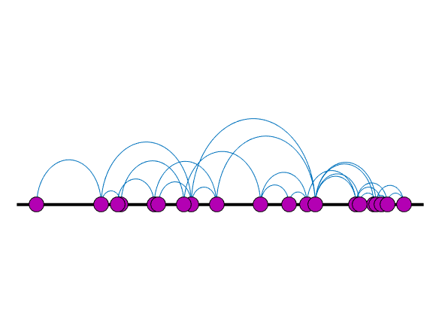
Space the points evenly

Slide 33
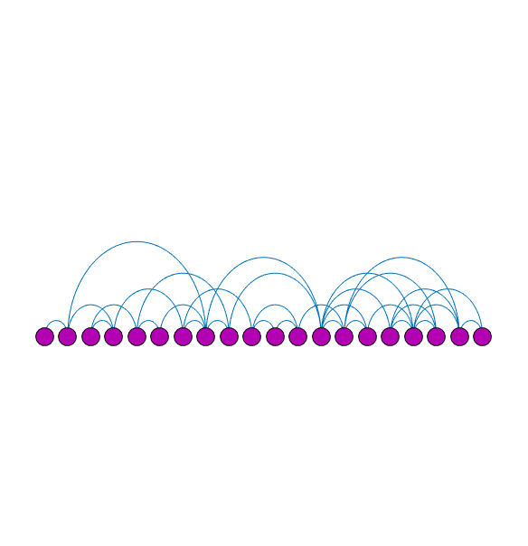
And, move them to the circle

Slide 34
Finish by putting me back in the center

Slide 35
Spectral Graph Drawing (Hall ’70)
Want to map with most edges short
Such that and
Minimize
and

Slide 36
Spectral Graph Drawing (Hall ’70)
Want to map with most edges short
Such that and
Minimize
and

Slide 37
Spectral Graph Drawing (Hall ’70)
Want to map with most edges short
Such that and
Minimize
and
and , to prevent

Slide 38
Spectral Graph Drawing (Hall ’70)
Such that
Minimize
and
Courant-Fischer Theorem:
solution is , up to rotation

Slide 39
Spectral Graph Drawing (Hall ’70)
9
1
2
3
5
3
2
4
1
6
7
5
6
4
8
8
9
7
Arbitrary
Drawing
Spectral
Drawing

Slide 40
Spectral Graph Drawing (Hall ’70)
Original
Drawing
Spectral
Drawing

Slide 41
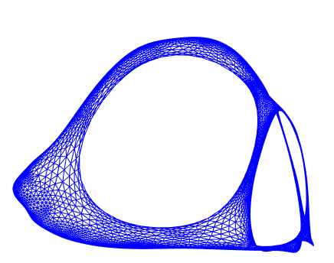
Spectral Graph Drawing (Hall ’70)
Original
Drawing
Spectral
Drawing

Slide 42
Dodecahedron
Best embedded by first three eigenvectors

Slide 43
Spectral drawing of Erdos graph:
edge between co-authors of papers

Slide 44
When there is a “nice” drawing:
Most edges are short
Vertices are spread out and don’t clump too much
is close to 0
When is big, say
there is no nice picture of the graph

Slide 45
Expanders: when is big
Formally: infinite families of graphs
of constant degree d and large
Examples: random d-regular graphs
Ramanujan graphs
Have no communities or clusters.
Incredibly useful in Computer Science:
Act like random graphs (pseudo-random)
Used in many important theorems and algorithms

Slide 46
Good Expander Graphs
-regular graphs with
Courant-Fischer: for all

Slide 47
Good Expander Graphs
-regular graphs with
Courant-Fischer: for all
For , the complete graph on vertices
, so for

Slide 48
Good Expander Graphs

Slide 49
Sparse Approximations of Graphs
(S-Teng ‘04)
A graph is a sparse approximation of
if has few edges and
few: the number of edges in is
or , where
if for all
Notes:
Got here in 20 minutes

Slide 50
Sparse Approximations of Graphs
(S-Teng ‘04)
A graph is a sparse approximation of
if has few edges and
few: the number of edges in is
or , where
if for all
Where
if
for all
Notes:
Got here in 20 minutes

Slide 51
Sparse Approximations of Graphs
(S-Teng ‘04)
A graph is a sparse approximation of
if has few edges and
few: the number of edges in is
or , where
if for all
Where
if
for all
Notes:
Got here in 20 minutes

Slide 52
Sparse Approximations of Graphs
(S-Teng ‘04)
The number of edges in is
or , where
Where
if
for all
Notes:
Got here in 20 minutes

Slide 53
Why we sparsify graphs
To save memory when storing graphs.
To speed up algorithms:
flow problems in graphs (Benczur-Karger ‘96)
linear equations in Laplacians (S-Teng ‘04)

Slide 54
Graph Sparsification Theorems
For every , there is a s.t.
and
(Batson-S-Srivastava ‘09)

Slide 55
Graph Sparsification Theorems
For every , there is a s.t.
and
(Batson-S-Srivastava ‘09)
By careful random sampling, can quickly get
(S-Srivastava ‘08)

Slide 56
Laplacian Matrices
Notes:
Get in edge vector earlier?

Slide 57
Laplacian Matrices

Slide 58
Laplacian Matrices

Slide 59
Matrix Sparsification

Slide 60
Matrix Sparsification
subset of vectors,
scaled up

Slide 61
Matrix Sparsification
subset of vectors,
scaled up

Slide 62
Matrix Sparsification

Slide 63
Simplification of Matrix Sparsification
is equivalent to

Slide 64
Simplification of Matrix Sparsification
Set
We need

Slide 65
Simplification of Matrix Sparsification
Set
“Decomposition of the identity”
“Parseval frame”
“Isotropic Position”
Notes:
Isotropic position, spherical set?

Slide 66
Matrix Sparsification by Sampling
(Rudelson ‘99, Ahlswede-Winter ‘02, Tropp ’11)
For with
Choose with probability
If choose , set

Slide 67
Matrix Sparsification by Sampling
(Rudelson ‘99, Ahlswede-Winter ‘02, Tropp ’11)
For with
Choose with probability
If choose , set
(effective conductance)

Slide 68
Matrix Sparsification by Sampling
(Rudelson ‘99, Ahlswede-Winter ‘02, Tropp ’11)
For with
Choose with probability
If choose , set

Slide 69
Matrix Sparsification by Sampling
(Rudelson ‘99, Ahlswede-Winter ‘02, Tropp ’11)
For with
Choose with probability
If choose , set
With high probability, choose vectors
and

Slide 70
Optimal (?) Matrix Sparsification
(Batson-S-Srivastava ‘09)
For with
Can choose vectors
and nonzero values for the so that

Slide 71
Optimal (?) Matrix Sparsification
(Batson-S-Srivastava ‘09)
For with
Can choose vectors
and nonzero values for the so that
What are the !?

Slide 72
Optimal (?) Matrix Sparsification
(Batson-S-Srivastava ‘09)
For with
Can choose vectors
and nonzero values for the so that
!?

Slide 73
The Kadison-Singer Problem ‘59
Equivalent to:
Anderson’s Paving Conjectures (‘79, ‘81)
Bourgain-Tzafriri Conjecture (‘91)
Feichtinger Conjecture (‘05)
Many others
Implied by:
Weaver’s KS₂ conjecture (‘04)
Notes:
Move it off this slide

Slide 74
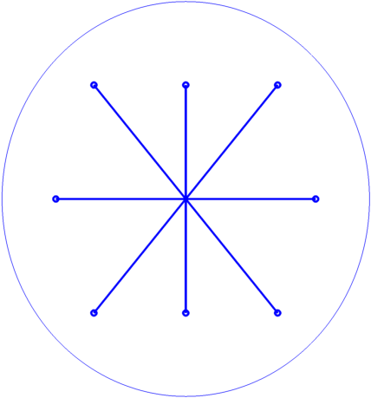
Weaver’s Conjecture: Isotropic vectors
for every unit vector

Slide 75
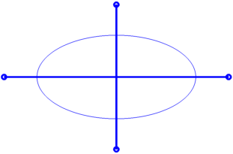
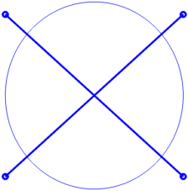
Partition into approximately ½-Isotropic Sets

Slide 76
Partition into approximately ½-Isotropic Sets

Slide 77
Partition into approximately ½-Isotropic Sets

Slide 78
Partition into approximately ½-Isotropic Sets
because

Slide 79
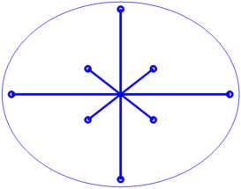
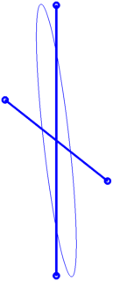
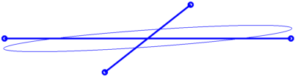
Big vectors make this difficult

Slide 80
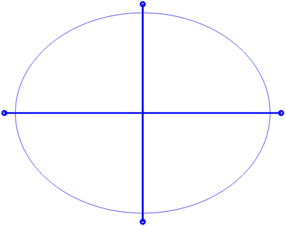
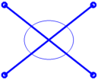
Big vectors make this difficult

Slide 81
Weaver’s Conjecture KS₂
There exist positive constants and so that
if all and
then exists a partition into S₁ and S₂ with

Slide 82
Theorem (Marcus-S-Srivastava ‘15)
For all
if all and
then exists a partition into S₁ and S₂ with

Slide 83
We want

Slide 84
We want

Slide 85
We want
Consider expected polynomial of a random partition.

Slide 86
Proof Outline
Prove expected characteristic polynomial
has real roots
Prove its largest root is at most
Prove is an interlacing family, so
exists a partition whose polynomial
has largest root at most

Slide 87
Interlacing
Polynomial
interlaces
if
Example:

Slide 88
Common Interlacing
and have a common interlacing if
can partition the line into intervals so that
each contains one root from each polynomial
)
(
)
(
)
(
)
(

Slide 89
Common Interlacing
If p₁ and p₂ have a common interlacing,
for some i.
Largest root
of average
)
(
)
(
)
(
)
(

Slide 90
Common Interlacing
If p₁ and p₂ have a common interlacing,
for some i.
Largest root
of average
)
(
)
(
)
(
)
(

Slide 91
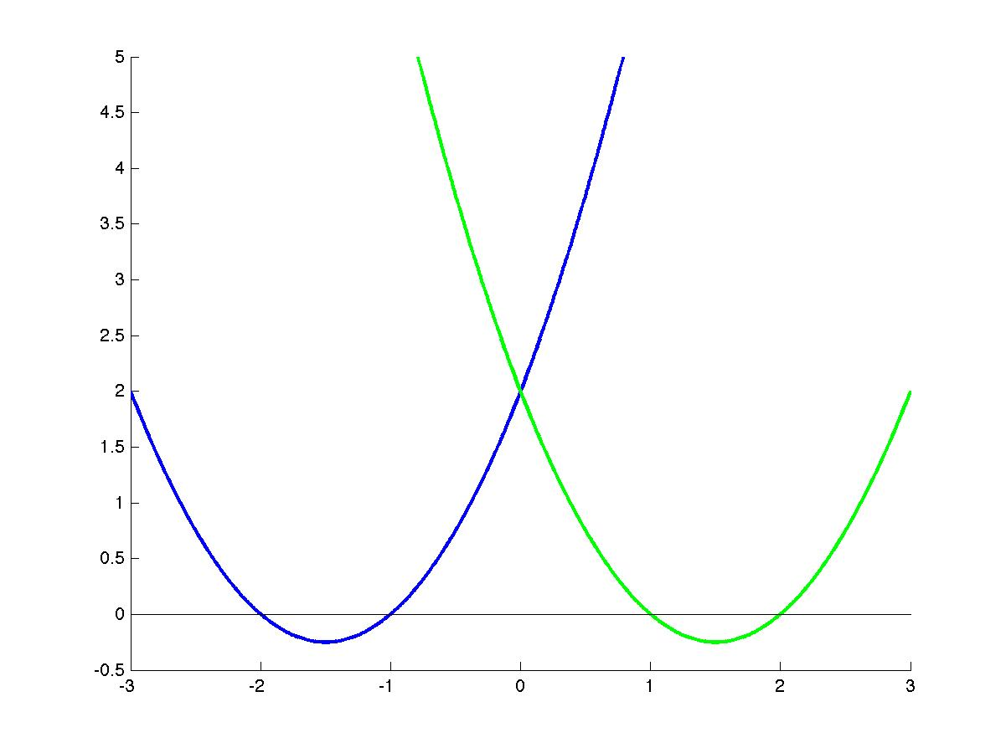
Without a common interlacing

Slide 92
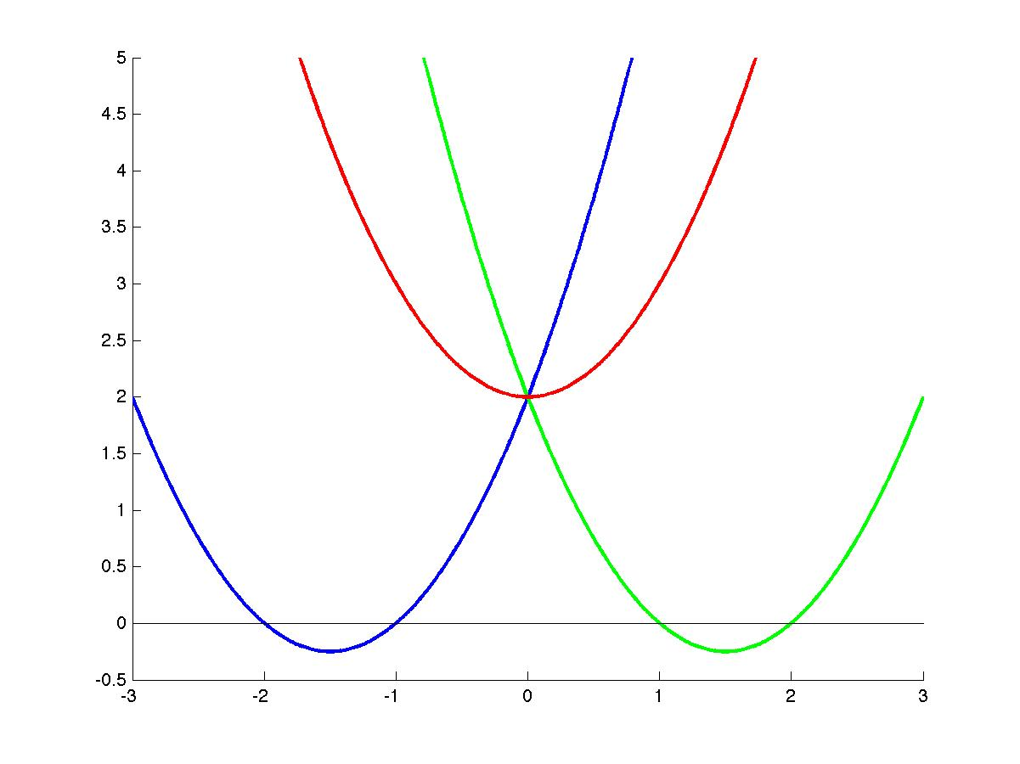
Without a common interlacing

Slide 93
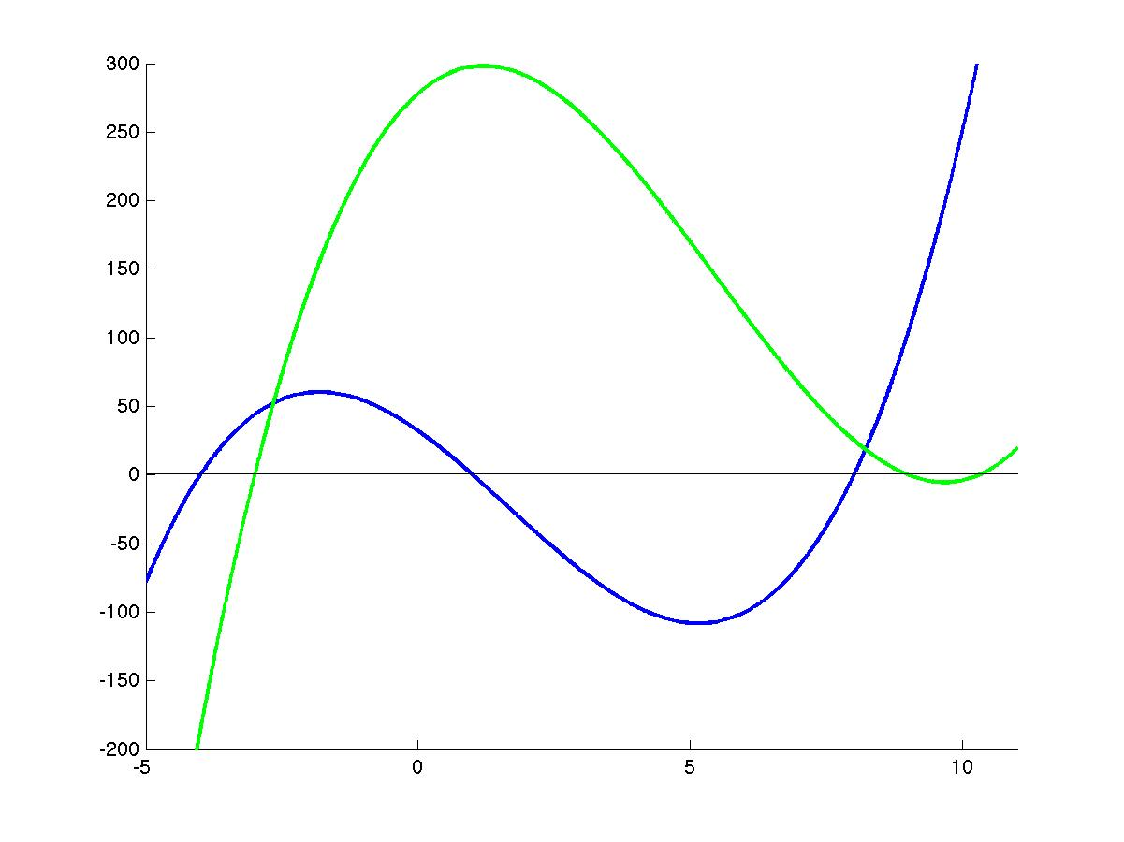
Without a common interlacing

Slide 94
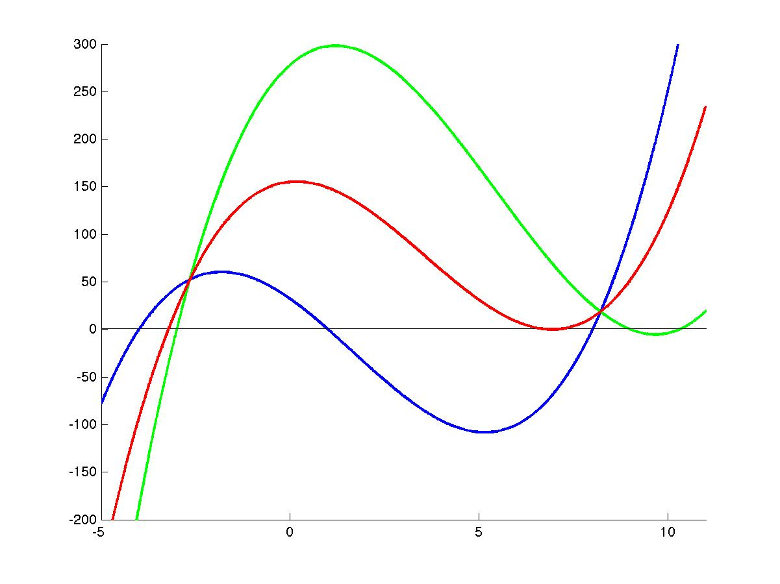
Without a common interlacing

Slide 95
Common Interlacing
If p₁ and p₂ have a common interlacing,
for some i.
Largest root
of average
)
(
)
(
)
(
)
(

Slide 96
Common Interlacing
and have a common interlacing iff
is real rooted for all
)
(
)
(
)
(
)
(

Slide 97
Interlacing Family of Polynomials
is an interlacing family
if its members can be placed on the leaves of a tree so that
when every node is labeled with the average of leaves below,
siblings have common interlacings

Slide 98
Interlacing Family of Polynomials
is an interlacing family
if its members can be placed on the leaves of a tree so that
when every node is labeled with the average of leaves below,
siblings have common interlacings
have a common
interlacing

Slide 99
Interlacing Family of Polynomials
is an interlacing family
if its members can be placed on the leaves of a tree so that
when every node is labeled with the average of leaves below,
siblings have common interlacings
have a common
interlacing

Slide 100
Interlacing Family of Polynomials
Theorem:
There is a so that

Slide 101
Interlacing Family of Polynomials
Theorem:
There is a so that
have a common
interlacing

Slide 102
Interlacing Family of Polynomials
Theorem:
There is a so that
have a common
interlacing

Slide 103
Our family is interlacing
Form other polynomials in the tree
by fixing the choices of where some vectors go

Slide 104
Summary
Prove expected characteristic polynomial
has real roots
Prove its largest root is at most
Prove is an interlacing family, so
exists a partition whose polynomial
has largest root at most

Slide 105
To learn more about Laplacians, see
My class notes from
“Spectral Graph Theory” and “Graphs and Networks”
My web page on
Laplacian linear equations, sparsification, etc.
To learn more about Kadison-Singer
Papers in Annals of Mathematics and survey from ICM.
Available on arXiv and my web page
Notes:
Weaver on was 15 minutes.

